Slide 1

PROJECT ON
World Wide Energy Consumption Analysis

Slide 2
Project Objective
To analyze global energy consumption, production, and emissions data across multiple countries using SQL and Power BI.
To understand the relationship between energy usage, economic growth (GDP), population, and environmental impact.
To identify high-emission and energy-intensive countries using comparative and per-capita analysis.
To present clear, visual insights that support data-driven decision-making and sustainability discussions.

Slide 3
Dataset Overview
This project uses global energy-related datasets sourced from a standardized public data provider.
The data is structured into 6 relational tables, enabling comparative and time-based analysis.
Each dataset captures a different dimension of energy, economy, and population.
Datasets Used
Country Contains the list of countries and acts as the central reference table.
Emission Stores total emissions by country, year, and energy type.
Consumption Records energy consumption values by country, year, and energy source.
Production Contains energy production data by country and year.
GDP Provides economic indicators (GDP values) by country and year.
Population Stores population values used for per-capita analysis.

Slide 4
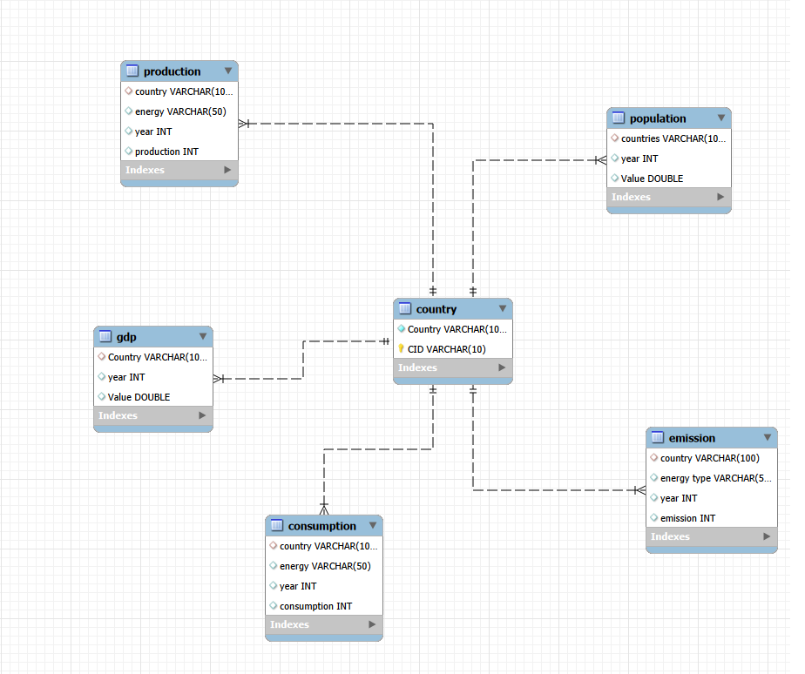

ER Diagram & Database Schema
Database Schema Overview
The Country table acts as the central master table.
All other datasets are connected to Country using country name and year.
This structure ensures data consistency and easy comparison across datasets.
Table Relationships
Country → Emission (One-to-Many) One country can have multiple emission records by year and energy type.
Country → Consumption (One-to-Many) Tracks energy consumption by country and year.
Country → Production (One-to-Many) Stores energy production details.
Country → GDP (One-to-Many) Maintains economic data by year.
Country → Population (One-to-Many) Stores population values for per-capita analysis.

Slide 5
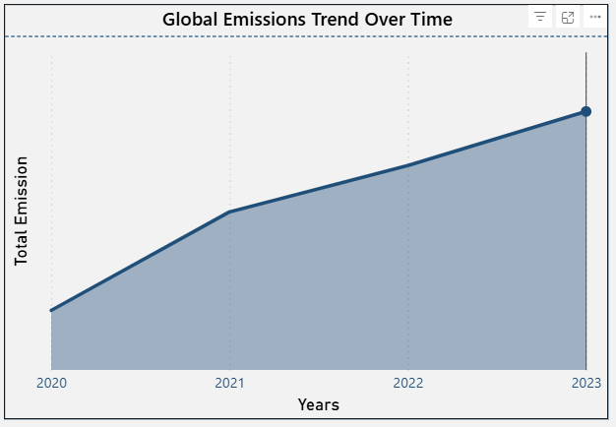
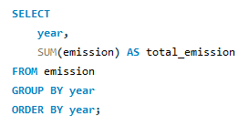
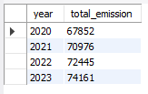
Global Emissions Trend Over Time
SQL Query
Content:
Global emissions show a consistent upward trend over the years.
Emissions increased steadily from 2020 to 2023.
No significant decline is observed during this period.
Insight:
Despite awareness and policies, global emissions continue to rise, highlighting the need for stronger sustainability actions.

Slide 6
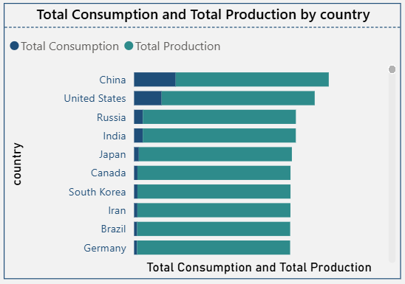
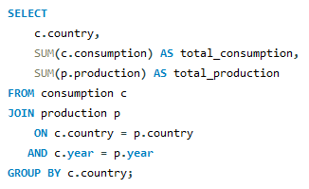
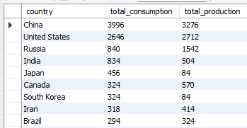
Total Consumption vs Total Production by Country
SQL Query
Content:
Several countries show higher energy consumption than production.
Some countries maintain a balanced or surplus energy production.
Energy patterns vary significantly across countries.
Insight:
Countries consuming more than they produce are energy-import dependent, which may impact energy security and costs.

Slide 7
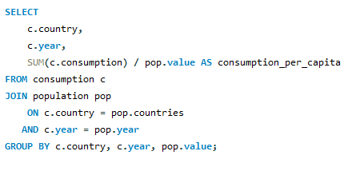
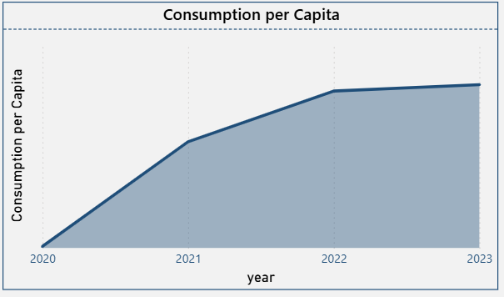
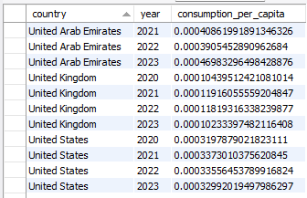
Energy Consumption per Capita
SQL Query
Content:
Per-capita energy consumption increased sharply from 2020 to 2021.
Growth continues but slows slightly after 2022.
Indicates rising energy usage per individual.
Insight:
Increasing per-capita consumption reflects changing lifestyles and higher energy dependency, especially in developing economies.

Slide 8
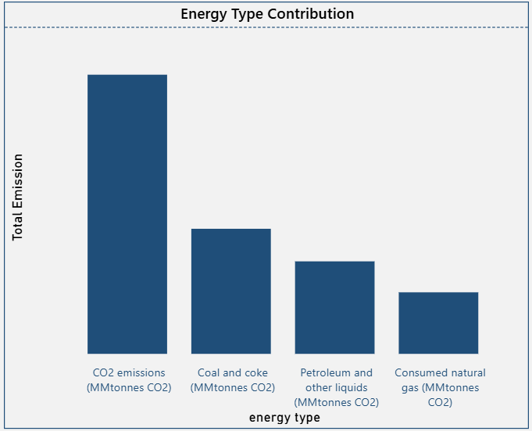
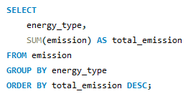
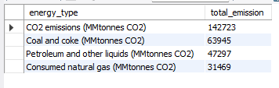
Energy Type Contribution to Emissions
SQL Query
Content:
CO₂-related energy sources contribute the highest emissions.
Fossil-fuel-based energy dominates emission levels.
Cleaner energy sources contribute comparatively less.
Insight:
Emissions are heavily driven by fossil fuel usage, emphasizing the need to accelerate adoption of renewable energy sources.

Slide 9
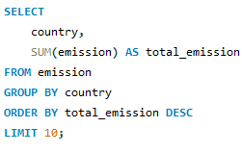
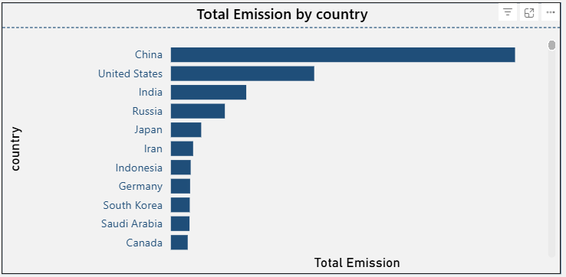
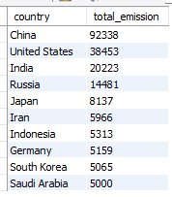
Total Emission by Country
SQL Query
Content:
A small number of countries contribute the major share of total emissions.
China and the United States lead global emissions.
Other countries contribute significantly less in comparison.
Insight:
Global emission reduction efforts should prioritize high-emission countries for maximum impact.

Slide 10
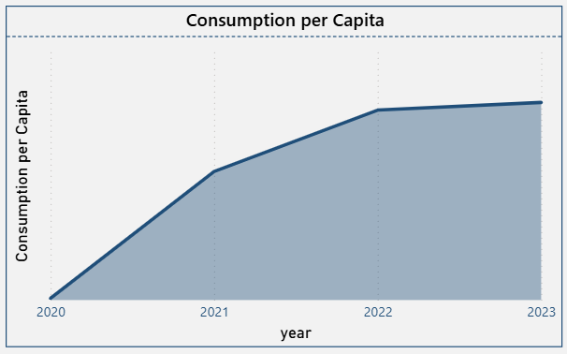
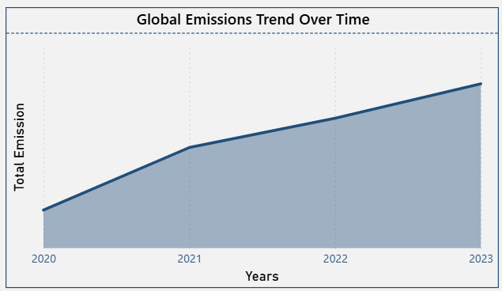

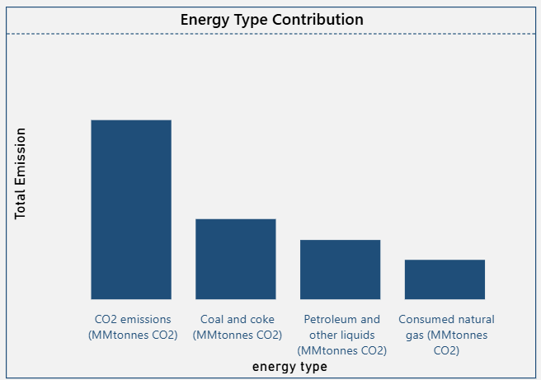
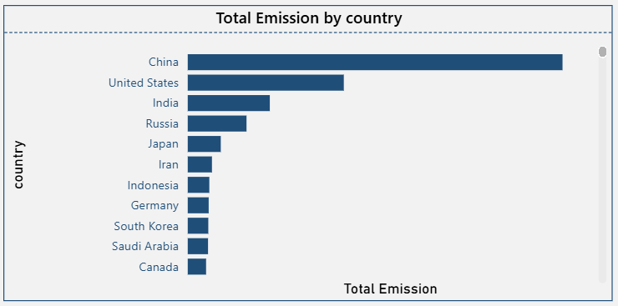
Summary of Insights from SQL Analysis

Slide 11
Conclusion (Key Findings Overall)
Global energy emissions show a consistent upward trend over time, indicating increasing energy demand worldwide.
A small number of countries contribute the majority of total emissions, highlighting the need for targeted emission control strategies.
Fossil-fuel-based energy sources remain the largest contributors to emissions, while cleaner energy sources have a smaller impact.
Energy consumption per capita has increased steadily, reflecting changing lifestyles and higher dependency on energy resources.
Differences between energy production and consumption across countries indicate varying levels of energy self-sufficiency and import dependency.

Slide 12
My Experience / Challenges During SQL–Data Analysis Project
Data Cleaning: I handled missing, duplicate, and inconsistent data before running SQL queries to ensure accurate results.
Working with Multiple Tables: Joining multiple tables using country and year required careful understanding of relationships and keys.
Query Performance: Some queries were slow while working with large data, so I learned how indexing and optimized queries improve performance.
Visualization: Converting SQL query outputs into clear and meaningful charts in Power BI helped me present insights effectively.
Key Learning: This project improved my understanding of SQL joins, data relationships, and how to convert raw data into useful business insights.

Slide 13

THANK
YOU

